Slide 1

Presentation
on
“PrenatalGuard: A Predictive Analytics Framework for Maternal Health Surveillance”
(AUG 29, 2025)
DEPARTMENT OF COMPUTER SCIENCE & ENGINEERING
CAY 2025-2026
Presented by:
2JH22CS018 CHRIS ALAXANDER
2JH22CS058 OMKAR F PATIL
2JH22CS077 SAGAR T
2JH22CS125 VISHWANATH M KARADIGUDD
Guided by:
Prof. AMRUTA NAVEEN
Dept of Computer Science
& Engineering

Slide 2
CONTENTS
INTRODUCTION
LITERATURE SURVEY
MOTIVATION
OBJECTIVES
PROBLEM STATEMENT
REQUIREMENT ANALYSIS
METHODOLOGY
IMPLEMENTATIONS
NEXT PHASE PLANS
CONCLUSION AND FUTURE WORK
REFERENCES
Dept of CSE, JCET, Hubballi 2025-2026 1

Slide 3
INTRODUCTION
Maternal health is a critical aspect of public health, especially in rural areas where healthcare services may be limited.
Many pregnant women face life-threatening complications during and post-pregnancy due to insufficient information about maternal health care.
Addressing this information gap is essential to reduce preventable deaths among pregnant women and neonates.
Dept of CSE, JCET, Hubballi 2025-2026 2

Slide 4
LITERATURE SURVEY
sl. no. | Author name | Title | Algorithm used | Published year | Result
1 | L. Adeola, C. Iwendi and K. Akeren | Using Machine Learning to Predict and Monitor Maternal Health Risk: A Case Study of Materna – an End User Web Application | decision trees, KNN, Random Forest, Neural Network, AdaBoost, XGBoost, CatBoost and Stochastic Gradient Boosting | 2025(IEEE) | Machine learning web application that will be able to detect maternal health with an accuracy of 84%.
2 | H. A. Shifa, M. U. Mojumdar, M. M. Rahman, N. R. Chakraborty and V. Gupta | Machine Learning Models for Maternal Health Risk Prediction based on Clinical Data. | ANN algorithm , Nave Bayes approach , K-Nearest Neighbors, dimension reduction | 2024(IEEE) | The ANN algorithm had an accuracy rate of 80%, whereas the Nave Bayes approach had a marginally lower accuracy rate of 70%.
3 | M. Ahmed and M. A. Kashem | IoT Based Risk Level Prediction Model For Maternal Health Care In The Context Of Bangladesh | GridSearchCV, decision tree | 2020(IEEE) | Decision Tree Algorithm gives the highest accuracy and the numeric value of this accuracy is 97%
4 | Anurag Kumar , Raj Gaurang Tiwari | Exploratory Data Analysis and Explainable Machine Learning for Classification of Maternal Health Risk Levels | decision trees, Logistic Regression, Random Forest, XGBoost | 2023(IEEE) | The Random Forest model achieved an accuracy of 94.26%.
Dept of CSE, JCET, Hubballi 2025-2026 3

Slide 5
5 | Subhash Mondal, Amitava Nag, Anup Kumar Barman and Mithun Karmakar | Machine learning-based maternal health risk prediction model for IoMT framework | NN-based BiLSTM, Random Forest Classifier (RF), Exploratory Data Analysis (EDA) | 2023 | The fine-tuned Random Forest Classifier (RF) achieves the highest accuracy of 93.14%
6 | Lawrence Merle Nelson Mary Elizabeth | Machine learning applied in maternal and fetal health: a narrative review focused on pregnancy diseases and complications | neural networks (NN), support vector machines (SVM), linear discriminant analysis (LDA). | 2020 | To describe the state of art regarding the use of ML in the context of pregnancy diseases and complications.
7 | Juan Li, Xin Li | Health Risk Prediction Using Big Medical Data- a Collaborative Filtering-Enhanced Deep Learning Approach | probabilistic matrix factorization (PMF), collaborative topic regression (CTR), convolutional neural network (CNN) | 2018 | This method can help us handle complex and multi-modality data.
Dept of CSE, JCET, Hubballi 2025-2026 4

Slide 6

MOTIVATION
The motivation behind predicting maternal health risks is to enhance pregnant women's health and well-being, reduce complications, and improve outcomes for both mother and babies.
Designed to serve both urban and rural healthcare environments, especially in low-resource settings.
Dept of CSE, JCET, Hubballi 2025-2026 5

Slide 7
OBJECTIVES
To execute a model that customizes risk assessments to fit each individual’s maternal health profile.
Usage of supervised machine learning algorithms, the model can learn from fresh data and identify intricate patterns.
To facilitate real-time input of data and provide timely health analysis allowing for quicker interventions and minimizing complications due to delayed treatment.
A responsive maternal health website must ensure mobile access, simple navigation, visual aids, multilingual support, fast loading and accessible UI for rural populations.
Dept of CSE, JCET, Hubballi 2025-2026 6

Slide 8
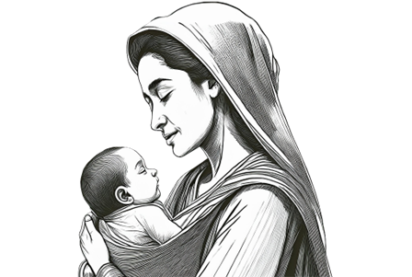
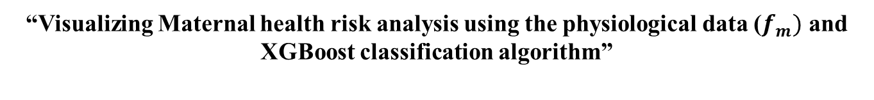
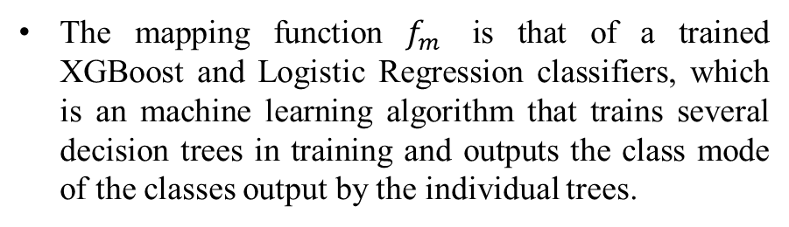
PROBLEM STATEMENT
“Visualizing Maternal health risk analysis using the physiological data ($f_{m})$ and XGBoost classification algorithm”
The mapping function $f_{m}$ is that of a trained XGBoost and Logistic Regression classifiers, which is an machine learning algorithm that trains several decision trees in training and outputs the class mode of the classes output by the individual trees.
Dept of CSE, JCET, Hubballi 2025-2026 7

Slide 9
REQUIREMENT ANALYSIS
Software Requirements:
Python.
Streamlit/Flask.
HTML, CSS and JavaScript.
Pickle.
Pandas.
Plotly/Matplotlib.
Sklearn.
IDE (VS Code and Jupiter notebook ).
Browser (Chrome).
Operating System (Windows).
Hardware Requirements:
Processor: Minimum Dual-core CPU.
RAM: 4 GB or higher.
Storage: At least 1 GB free space.
Dept of CSE, JCET, Hubballi 2025-2026 8

Slide 10
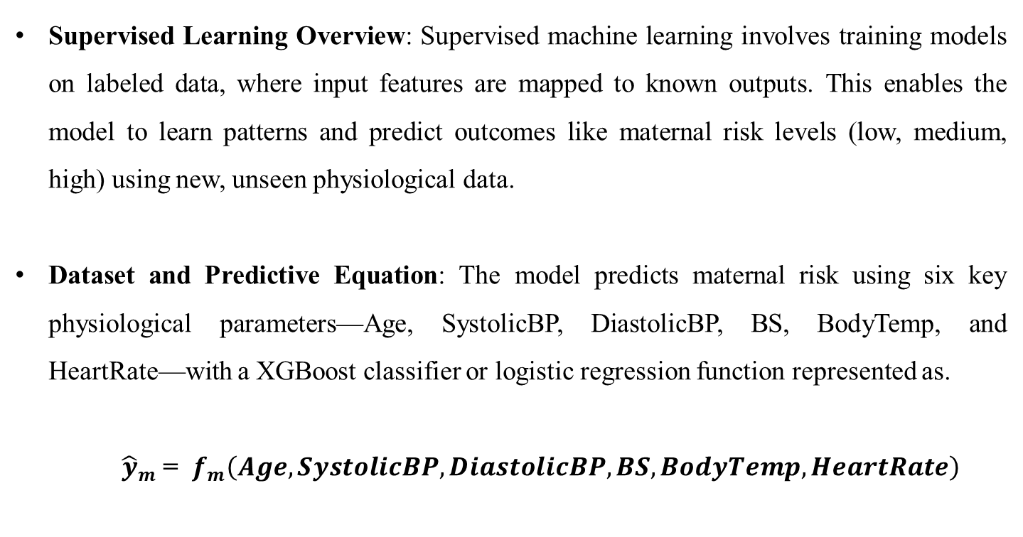
METHODOLOGY
Supervised Learning Overview: Supervised machine learning involves training models on labeled data, where input features are mapped to known outputs. This enables the model to learn patterns and predict outcomes like maternal risk levels (low, medium, high) using new, unseen physiological data.
Dataset and Predictive Equation: The model predicts maternal risk using six key physiological parameters—Age, SystolicBP, DiastolicBP, BS, BodyTemp, and HeartRate—with a XGBoost classifier or logistic regression function represented as.
${\hat{y}}_{m}$ = $f_{m}\left(Age,SystolicBP,DiastolicBP,BS,BodyTemp,HeartRate\right)$
Dept of CSE, JCET, Hubballi 2025-2026 9

Slide 11
Analysis & Dominant Predictors: Statistical models (like logistic regression) and ensemble models (like XGBoost) analyze the importance of each feature. Blood sugar (BS) and blood pressure are the most influential predictors, heavily impacting risk classification, as validated by feature importance and model coefficients.
Data saving and visualizing: collecting health data, preprocessing it for consistency, and storing it securely in databases. Using machine learning models like XGBoost, predictions are generated. Visualization tools then present time-series monthly data comparisons through interactive charts, enabling trend analysis and informed decision-making in maternal health management.
Dept of CSE, JCET, Hubballi 2025-2026 10

Slide 12

Data saving and visualizing: collecting health data, preprocessing it for consistency, and storing it securely in databases. Using machine learning models like XGBoost, predictions are generated. Visualization tools then present time-series monthly data comparisons through interactive charts, enabling trend analysis and informed decision-making in maternal health management.
Dept of CSE, JCET, Hubballi 2025-2026 11

Slide 13
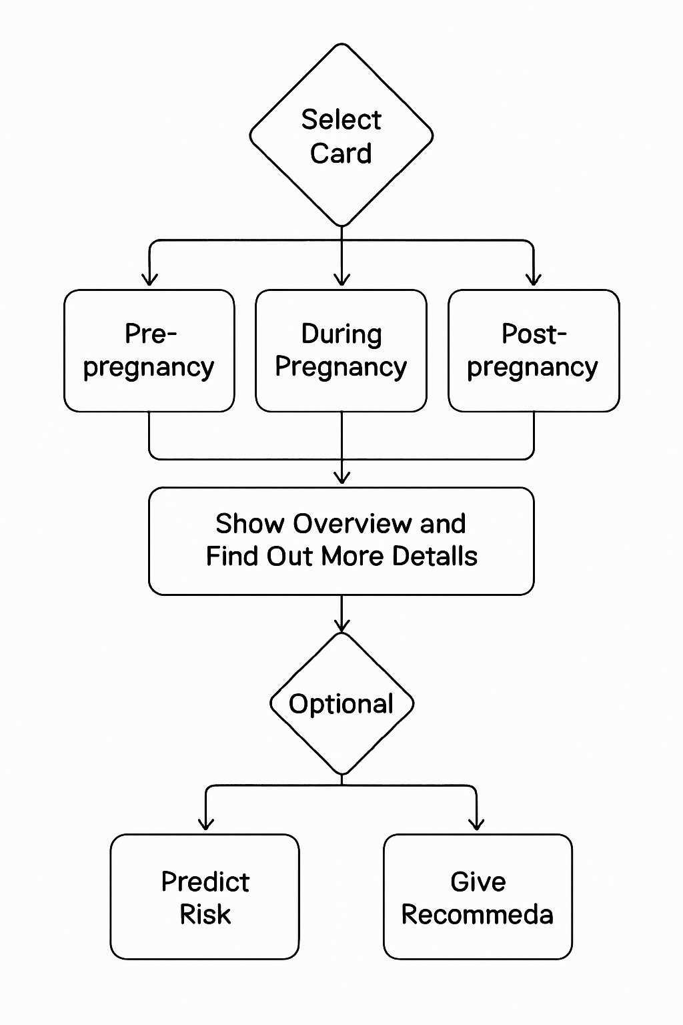
Block diagram
TOTAL MODEL FLOW CHART
Dept of CSE, JCET, Hubballi 2025-2026 12

Slide 14
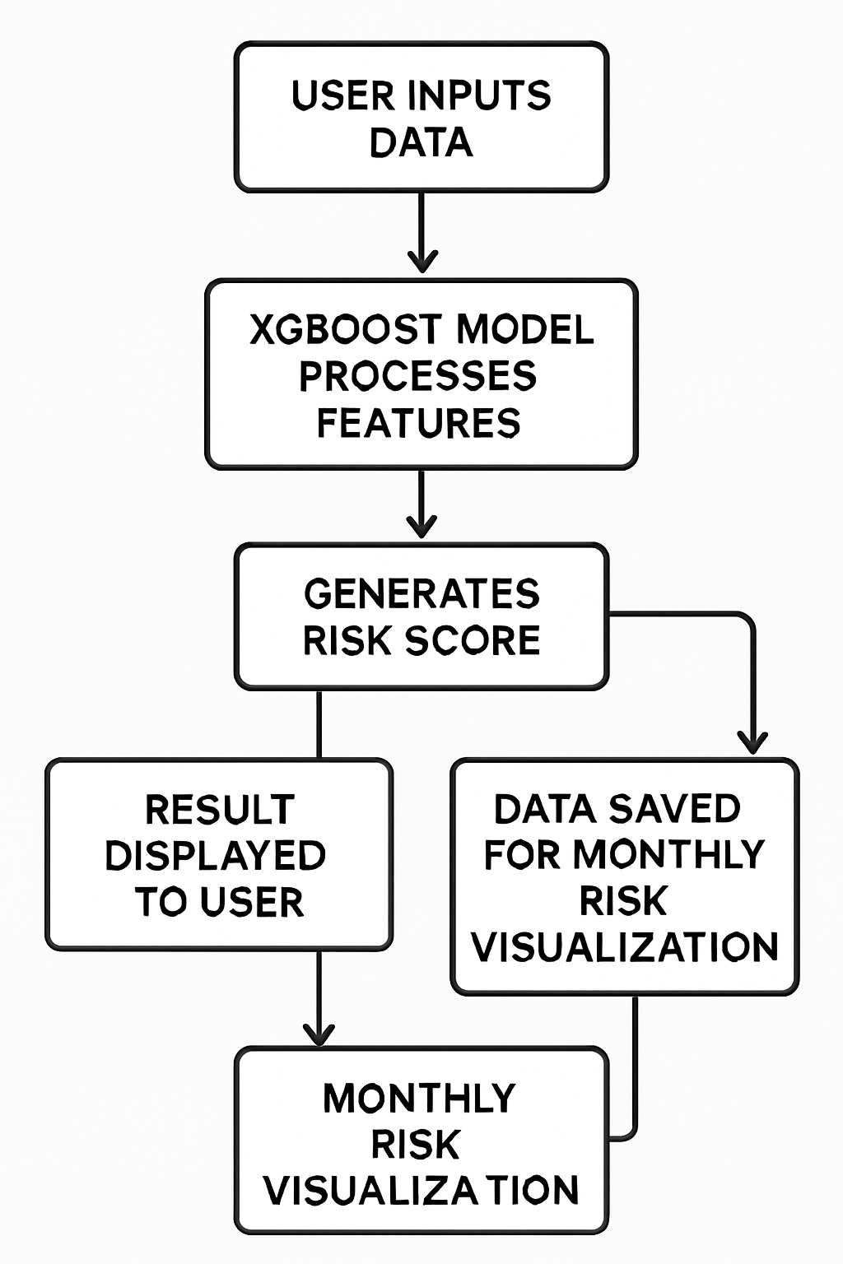
Block diagram
CONTINUATION OF THE PREDICT RISK MODEL
Dept of CSE, JCET, Hubballi 2025-2026 13

Slide 15
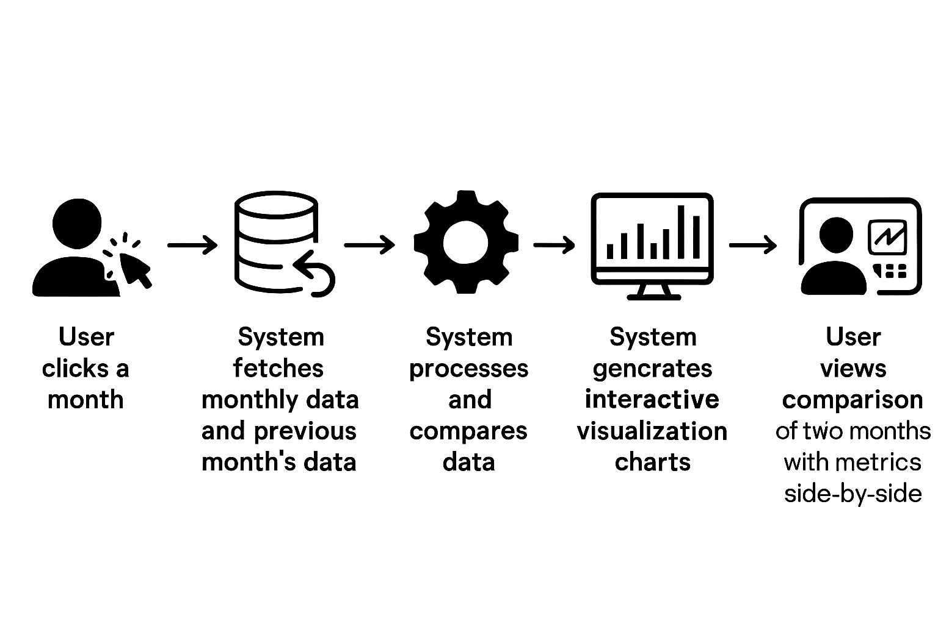
Block diagram
CONTINUATION OF THE DATA SAVING AND THE MONTHLY DATA VISUALIZATION
Dept of CSE, JCET, Hubballi 2025-2026 14

Slide 16
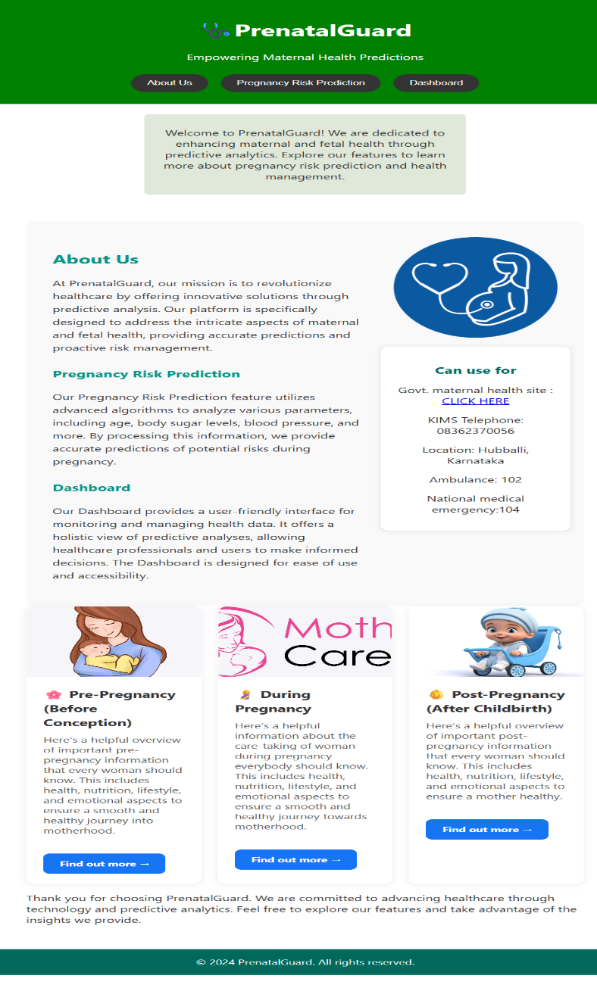
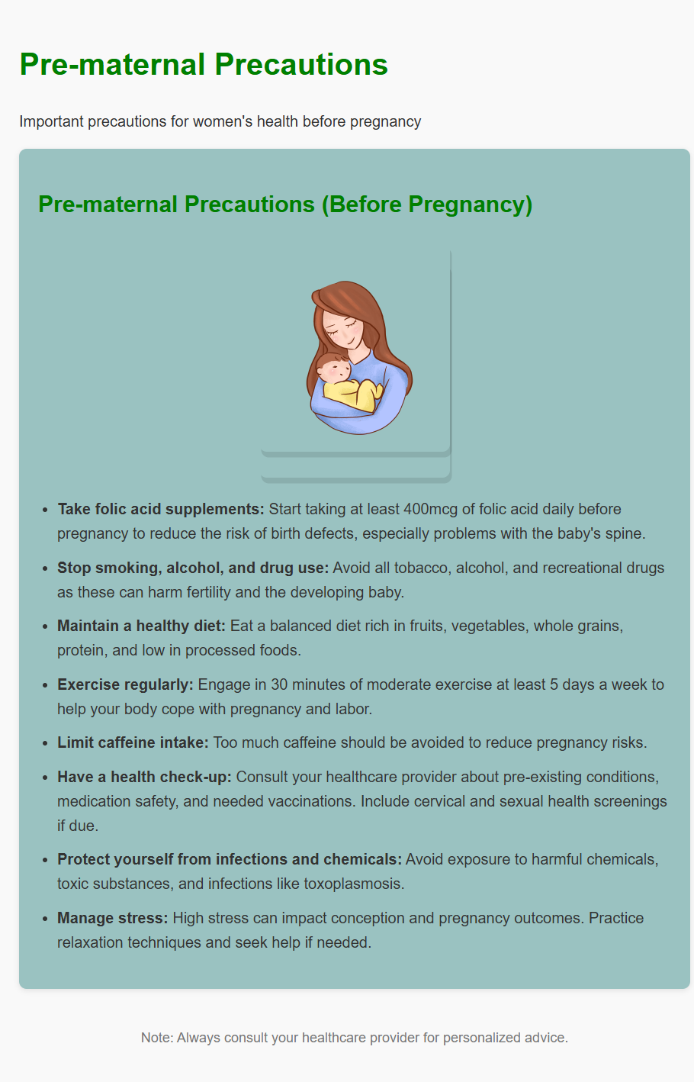
IMPLEMENTATIONS
Pre-maternal precautions card render page
Landing page with precaution cards
Dept of CSE, JCET, Hubballi 2025-2026 15

Slide 17
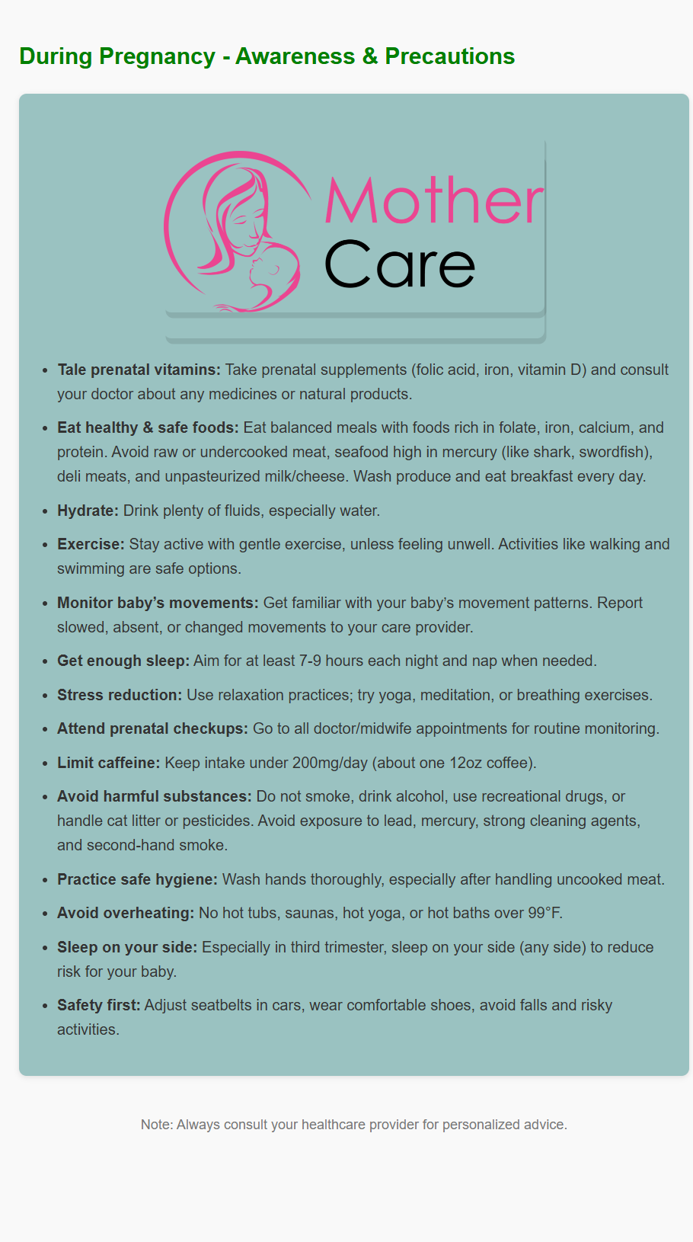
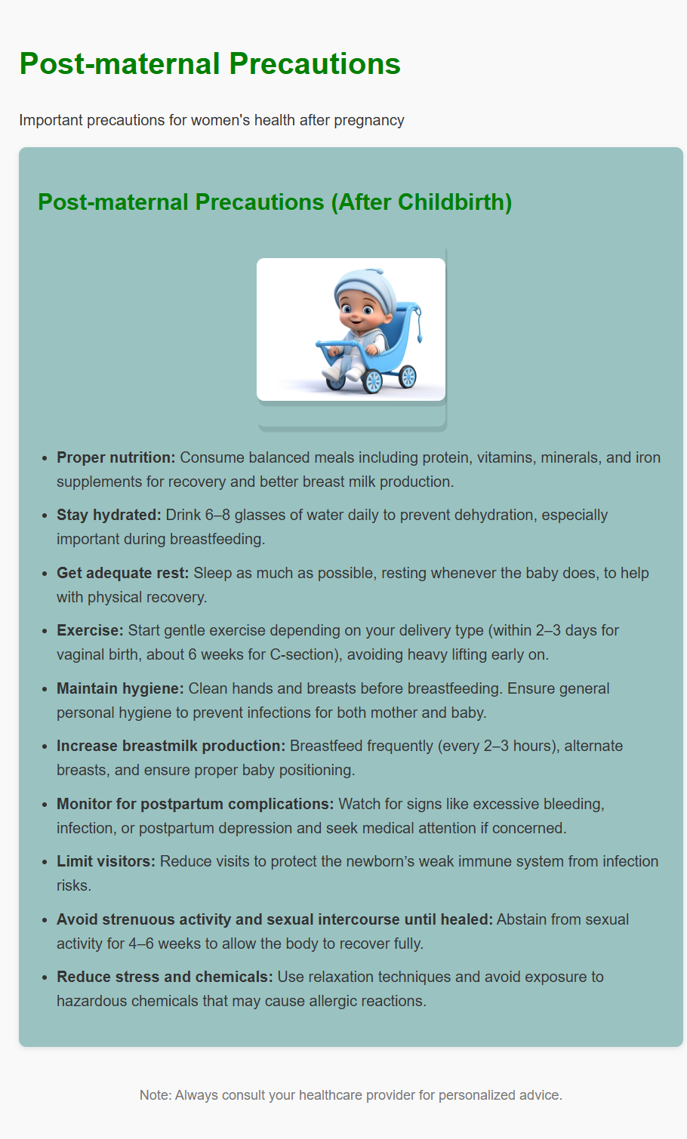
During-maternal precautions card render page
Post-maternal precautions card render page
Dept of CSE, JCET, Hubballi 2025-2026 16

Slide 18
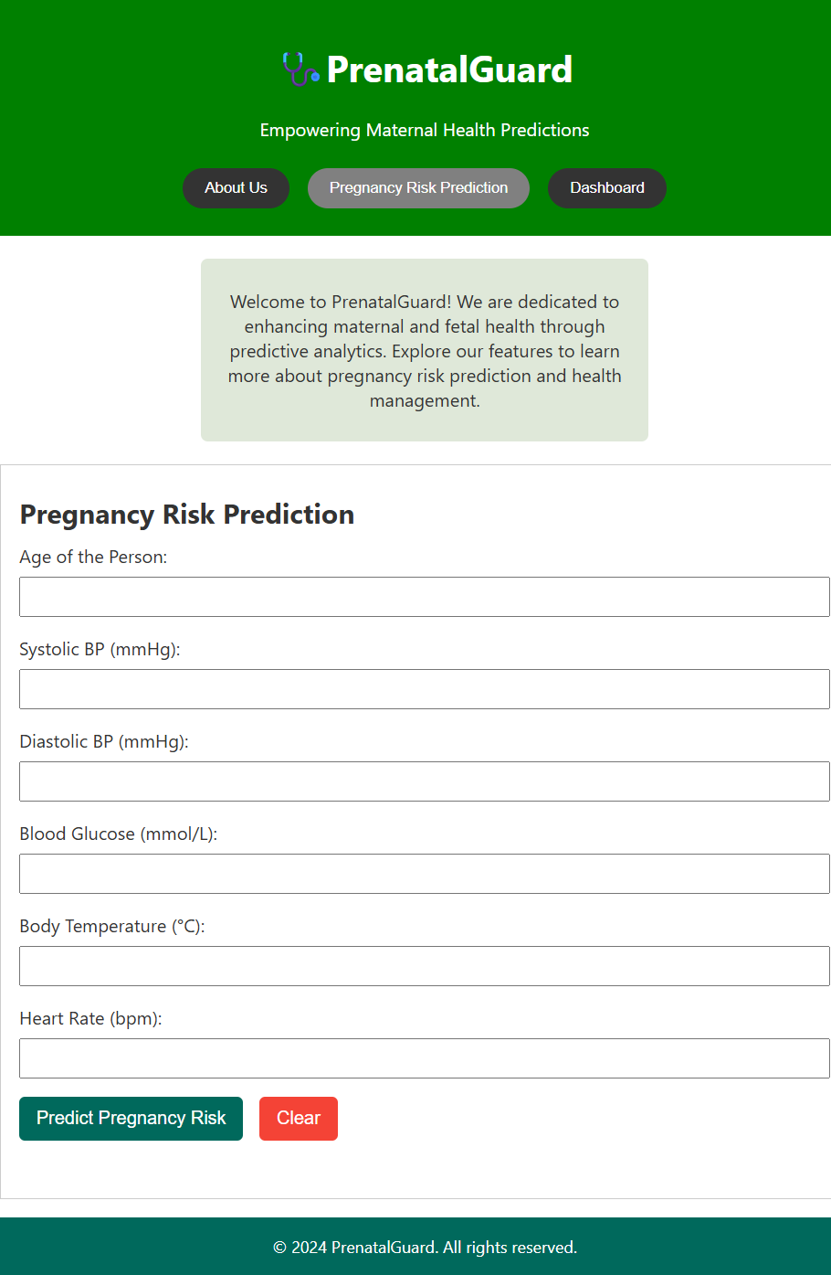
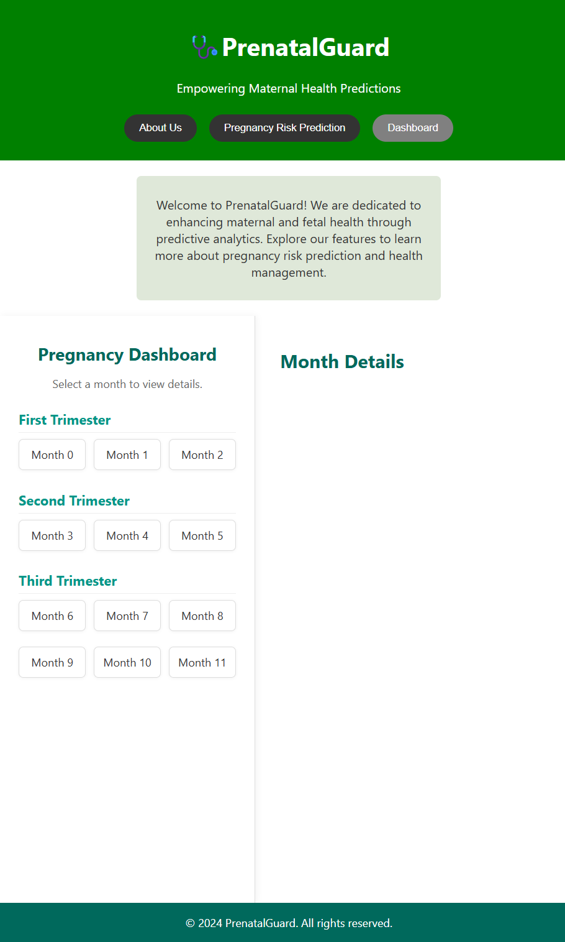
Data input and Prediction page
Storage retrieval and visualization page
Dept of CSE, JCET, Hubballi 2025-2026 17

Slide 19
NEXT PHASE PLANS
In the next phase, we will train and test the XGBoost model save it as a pickle file and integrate it with our frontend. Following this, the predicted values and recommendations will be stored.
In the final phase, we will focus on data visualization and project deployment.
Dept of CSE, JCET, Hubballi 2025-2026 18

Slide 20
CONCLUSION
This project integrates predictive analytics and data visualization to enhance maternal health. It offers an interactive platform for pregnancy risk prediction, presents health information across pregnancy stages, and visualizes monthly health trends, empowering timely decision-making and proactive care for improved maternal and fetal outcomes.An Interactive website that:
Takes user input (age, BP, temp, heart rate).
Sends it to the backend.
Returns and displays predicted maternal health risk.
Can view the previous report and recommendations
Dept of CSE, JCET, Hubballi 2025-2026 19

Slide 21
FUTURE WORK
Enhancing prediction accuracy using advanced AI models like deep learning or ensemble methods with larger diverse datasets.
Expanding multilingual and voice-assisted interfaces to reach wider rural and low-literacy populations globally.
Leveraging blockchain for secure, transparent patient data management and consent-driven information sharing.
Dept of CSE, JCET, Hubballi 2025-2026 20

Slide 22
REFERENCES
[1] L. Adeola, C. Iwendi and K. Akeren, "Using Machine Learning to Predict and Monitor Maternal Health Risk: A Case Study of Materna – an End User Web Application" Published on 2025(IEEE) .
[2] H. A. Shifa, M. U. Mojumdar, M. M. Rahman, N. R. Chakraborty and V. Gupta, "Machine Learning Models for Maternal Health Risk Prediction based on Clinical Data" Published on 2024(IEEE) .
[3] M. Ahmed and M. A. Kashem, "IoT Based Risk Level Prediction Model For Maternal Health Care In The Context Of Bangladesh" Published on 2020(IEEE) .
[4] S. S. L. Pereira et al., "Improving Maternal Risk Analysis in Public Health Systems" Published on 2020(IEEE) .
Dept of CSE, JCET, Hubballi 2025-2026 21

Slide 23
Q and A

Slide 24
SUGGESTIONS

Slide 25
THANK YOU

